Slide 1
Summer Experiences: Ghana
Sarah Yu | Oct 11, 2016

Slide 2
Study Abroad Experiences
Peru - Summer 2015
Georgia - Early Fall 2015
Oman & Qatar - Spring 2016
Ghana - Summer 2016
Notes:
Opportunities that UW makes available, community among students, and faculty

Slide 3
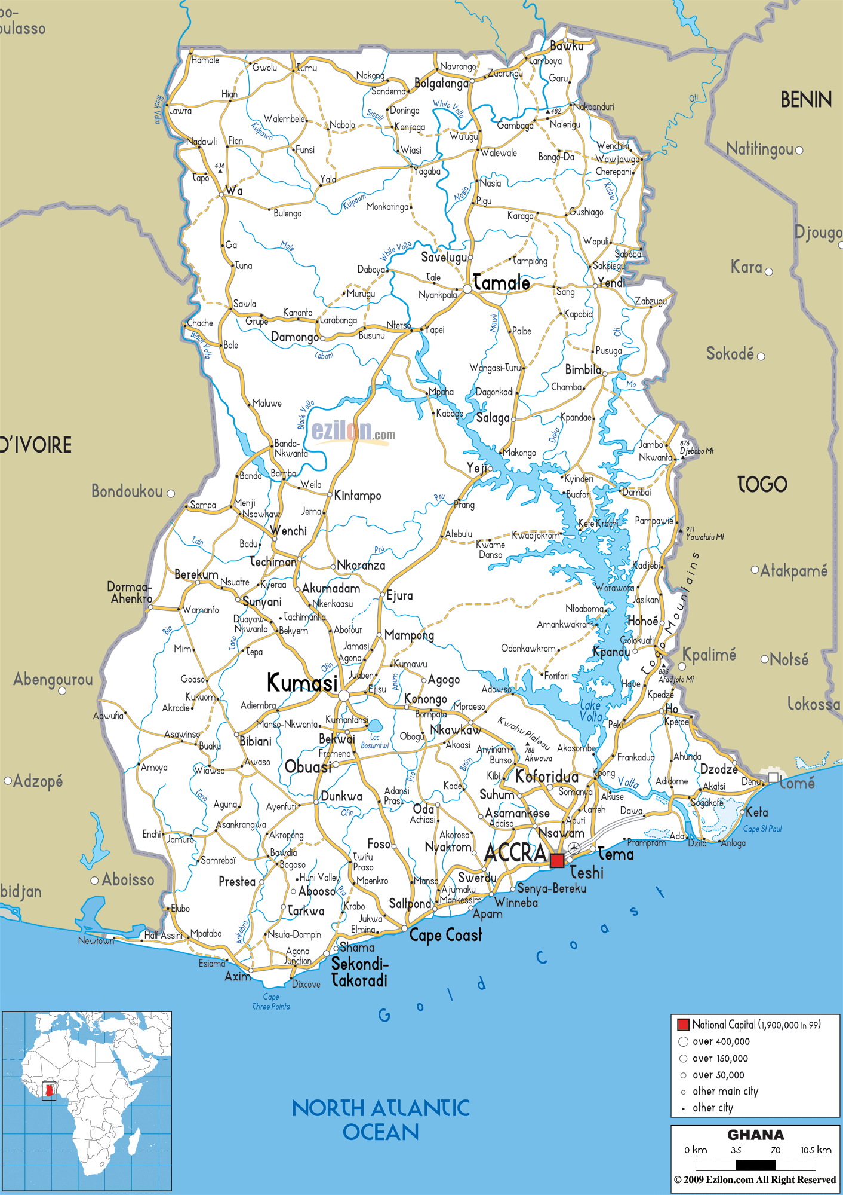
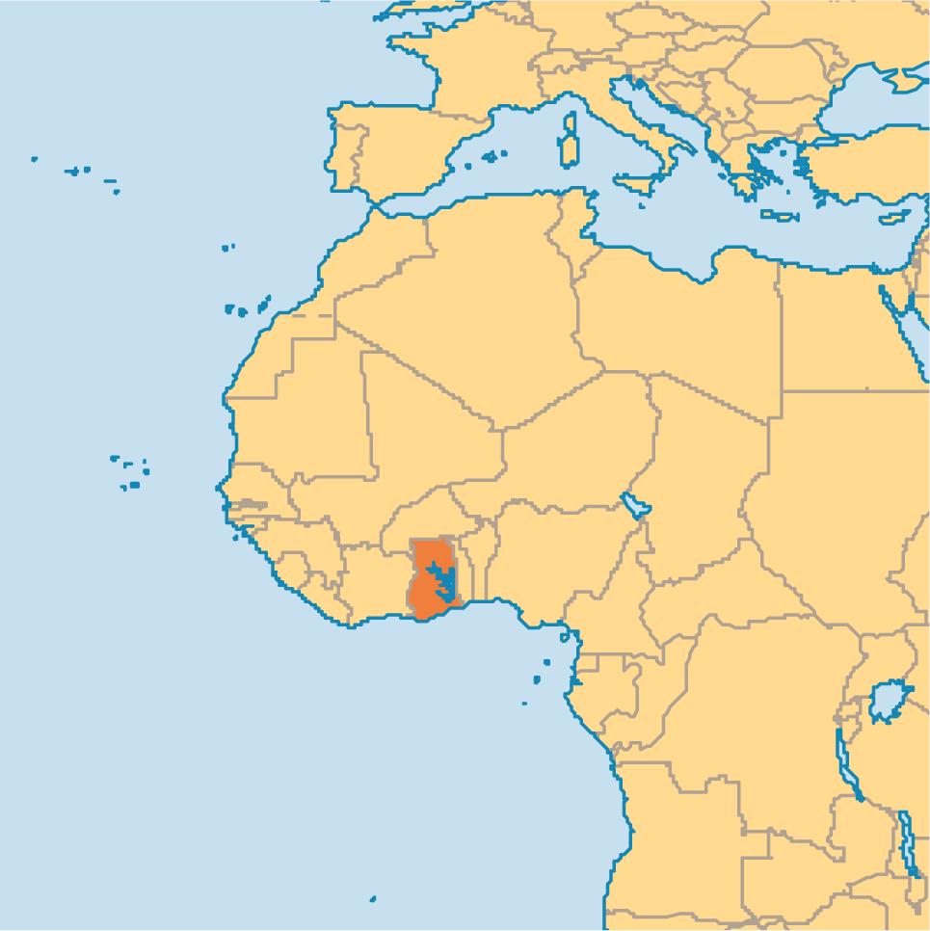
Structure of Program
Aug 27 - Sep 23 | iSchool
Accra
Ada
Ho
Kumasi
Cape Coast

Slide 4
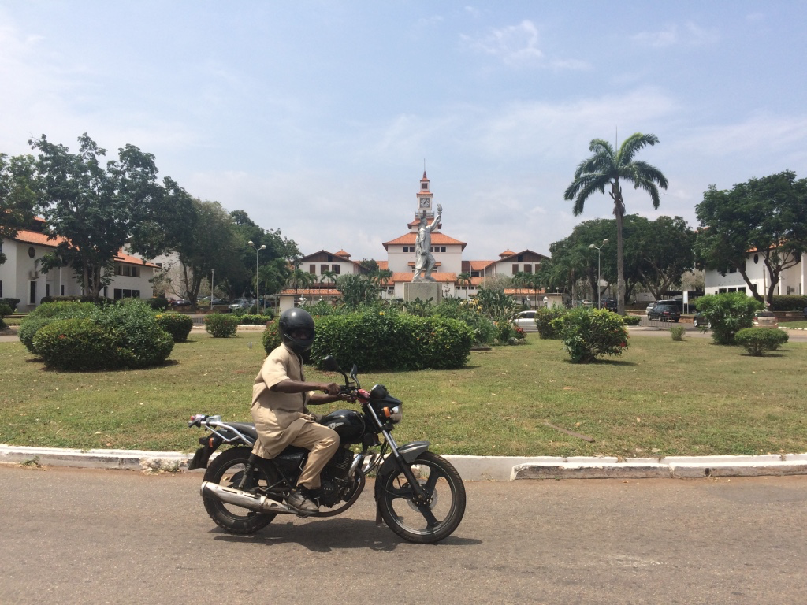
Accra
Capital
Urban/Coastal
Growing Mobile Money Market
Interviews with students
University of Ghana - Legon Campus

Slide 5
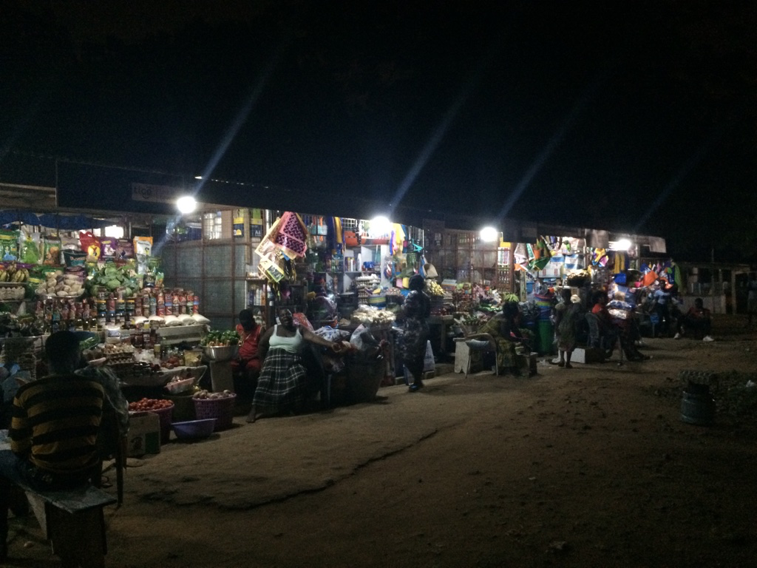
Notes:
Market in Accra

Slide 6
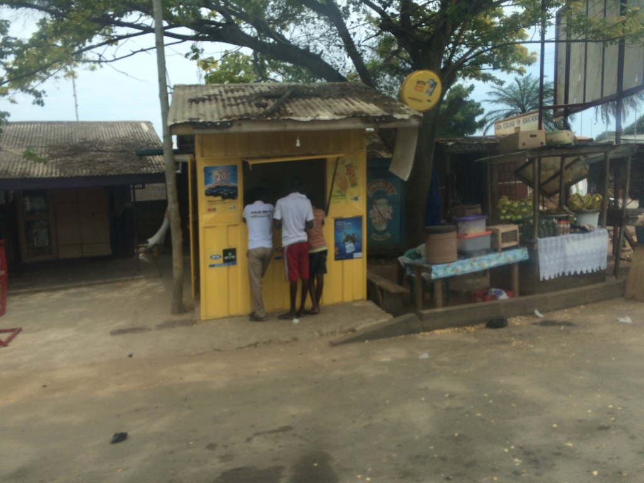
Ada / Ho
Rural
Mature Mobile Money Market

Slide 7
Kumasi / Cape Coast
Semi-Urban
Growing Mobile Money Market

Slide 8
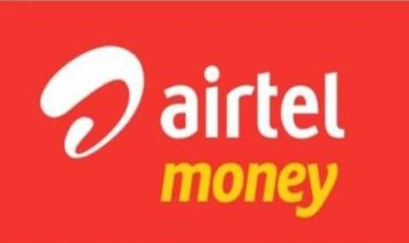
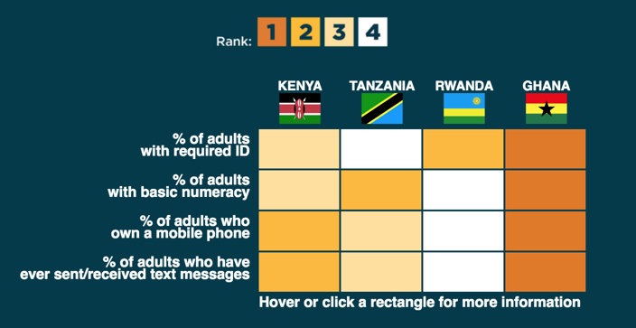
Pre-Departure
What is holding back mobile money adoption in Ghana?
Notes:
Pre-Ghana research plane, field research,

Slide 9
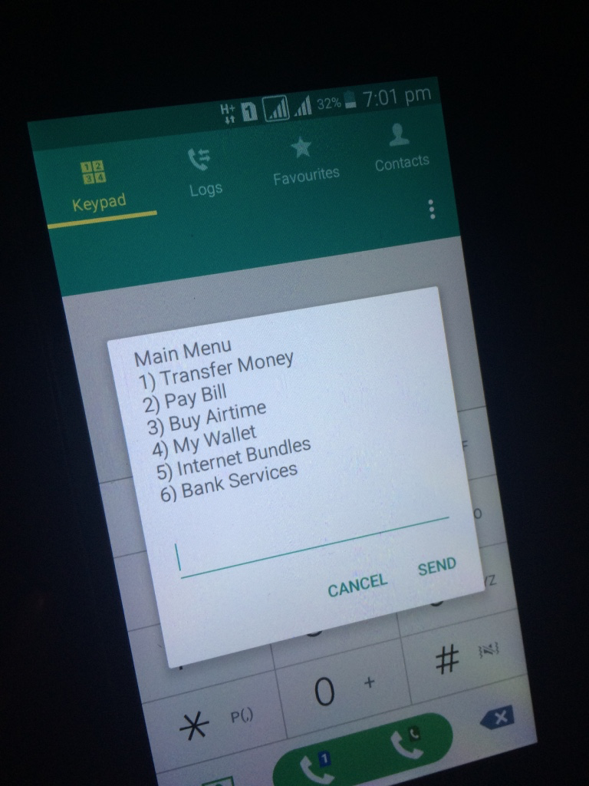
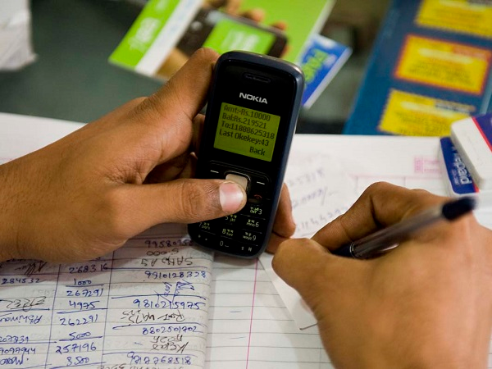
Using Mobile Money

Slide 10
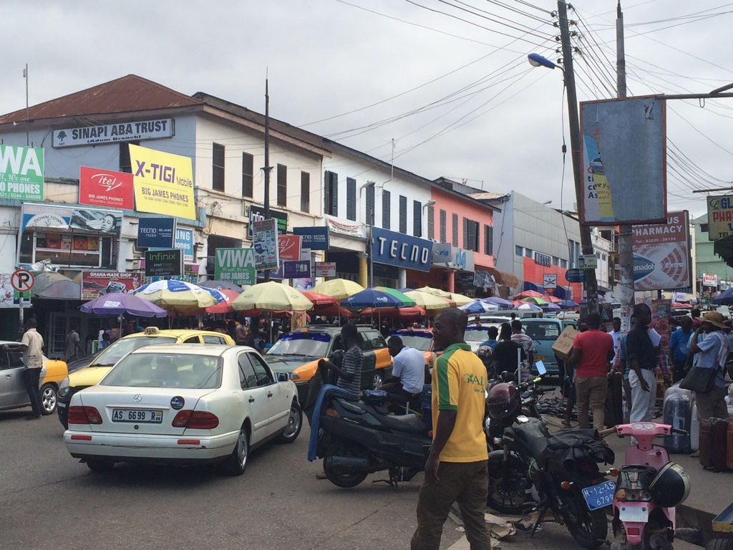
Findings
Disparity between Literature and Field

Slide 11
Findings
What do people use mobile money for?
“Why aren’t people using bill pay?”
“People don’t have a lot of bills to pay”
Larger social transactions to friends and family
Transitioning towards merchant payments

Slide 12
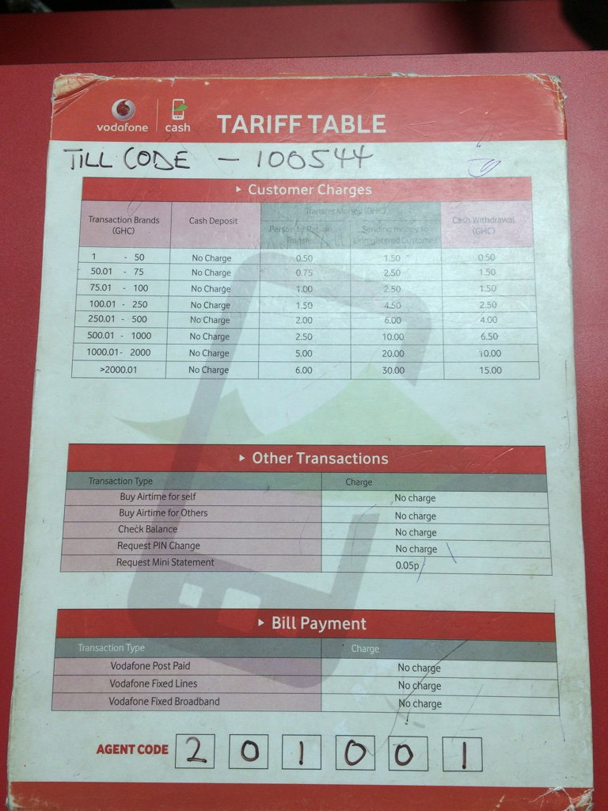
Findings
How to people see and understand fee structures?
How do people change their spending based on tariffs?

Slide 13
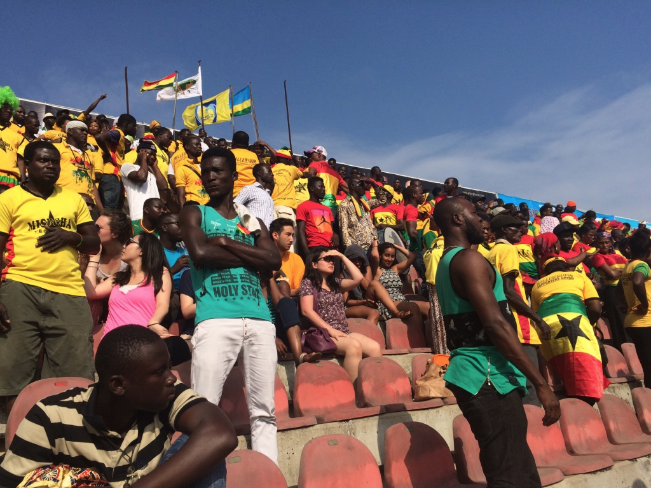

Slide 14
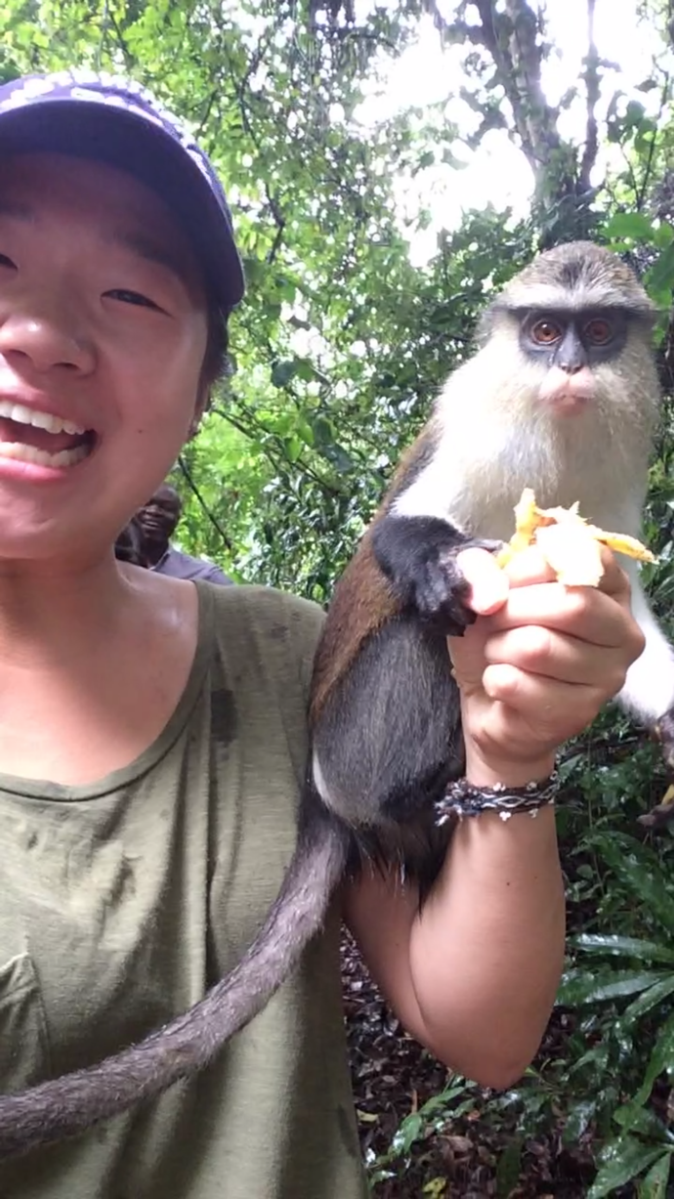
Questions?

